Slide 1
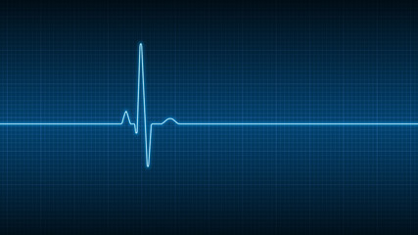


ECG Signal Processing
Ujjwal Dwivedi
SC19B128
Department of Avionics – V Semester

Slide 2
Outline of the Presentation
Introduction
Artifacts in ECG Signals
Objectives
ECG Signal Database
Techniques to remove artifacts from ECG Signal
Discrete Wavelet Transform
(i) Biorthogonal Wavelet
(ii) Daubechies Wavelet
Generation of PQRST waves
Elements of ECG Signal
Scope and Limitation of the study
MATLAB Simulation Result
References

Slide 3
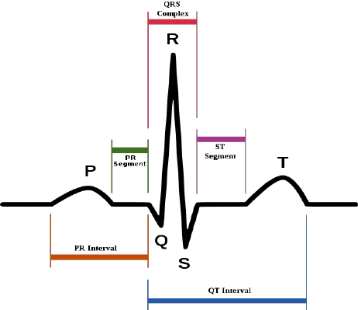
Introduction
Electrocardiogram (ECG) is a signal that describes
the electrical activity of the heart. The ECG signal is
generated by contraction (depolarization) and relaxation
(repolarization) of atrial and ventricular muscles of the
heart. The ECG signal contains- a P wave (due to atrial
depolarization), a QRS complex (due to atrial repolarization
and ventricular depolarization) and a T wave (due to
ventricular repolarization).

Slide 4
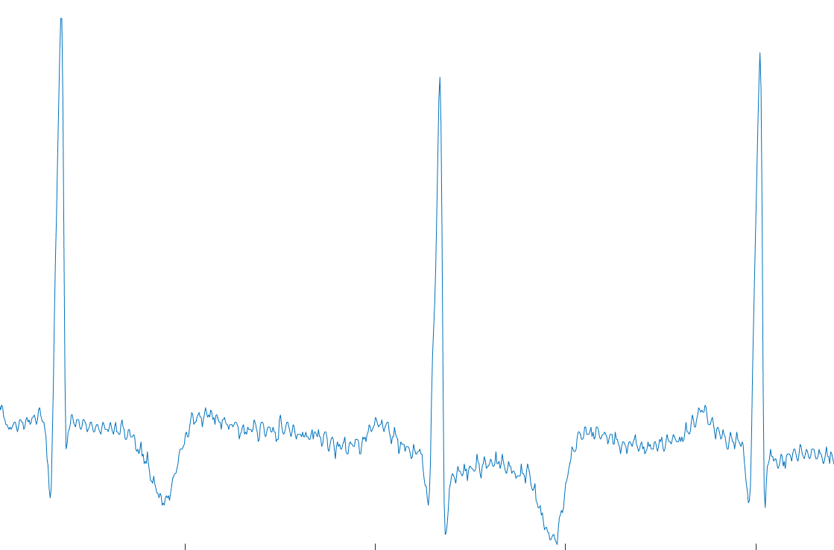
Artifacts in ECG Signals
Artifacts (noise) are the unwanted signals that are
merged with ECG signal. It is necessary to remove
them from ECG signals using proper signal
processing methods. There are mainly four
types of artifacts encountered in ECG signals:
baseline wander, powerline interference, EMG
noise and electrode motion artifacts.

Slide 5
Objectives
To observe the ECG signals taken from the database of a MIT-BIH Arrhythmia patients.
To perform the pre-processing required to remove the Artifacts from the ECG signal using filtering method.
To detect the PQRST waves of ECG signal and determine the heartbeat of a patient.

Slide 6
ECG Signal Database
Database used in this project is a standard data taken from MIT-BIH Arrythmia Database.
Database is observed using two-channel ambulatory ECG recordings and it is obtained from 47 subjects studied by the BIH Arrhythmia Laboratory between 1975 and 1979.
ECG signal is recorded for 10 seconds, and sampling frequency used is 360Hz with a voltage gain of 200.

Slide 7
Removal of Artifacts from ECG Signal
Removal of Baseline Wander
It can be removed using Discrete Wavelet Transform (DWT). The frequency content of the baseline wander is in the range of 0.67Hz. It will require nine-level decomposition of original signal using DWT to remove the baseline wander of required frequency.
Removal of Powerline Interference
It can be removed using a notch filter concentrated at 50Hz with a 3-dB bandwidth of 5Hz.
Removal of EMG – High Frequency Noise
It can be removed using Discrete Wavelet Transform (DWT). Most of the information available in the ECG signal lies in the range of 0.5-150 Hz. It will require two-level decomposition of original signal using DWT to remove the high frequency noise.

Slide 8
Discrete Wavelet Transform
Discrete Wavelet Transform (DWT) decomposes a signal into a set of mutually orthogonal wavelet basis functions. Wavelet functions are dilated, translated and scaled versions of a common function φ, known as the mother wavelet.
DWT has the ability to perform frequency resolution as well as temporal resolution i.e., it can provide information about the frequency components of the wave and its location.
There are several families of wavelet transforms which are identified by their mother wavelet, most common are Haar, Shannon, Daubechies, Spline, Biorthogonal, Mexican hat, etc.
In this project, for the removal of artifacts from the ECG signal, we have used Biorthogonal wavelet transform whereas for the detection PQRST waves in the ECG signal, we have used Daubechies wavelet transform.

Slide 9
Discrete Wavelet Transform (contd.)
To perform the DWT, input signal is given to a low pass filter to obtain the approximate coefficients and simultaneously input signal is also given to a high pass filter to obtain the detailed coefficients.
Detailed coefficients are fixed but approximate coefficients can be modified.
To perform further decomposition of input signal into higher scales, approximate coefficients are down sampled by the factor of 2 and given to another set of high pass and low pass filter to obtain the level 2
approximation and detailed coefficients.
In this project, for the removal of baseline wander noise, we are required to perform nine-level decomposition whereas for the removal of EMG noise, we are required to perform two-level decomposition of the ECG signal.

Slide 10
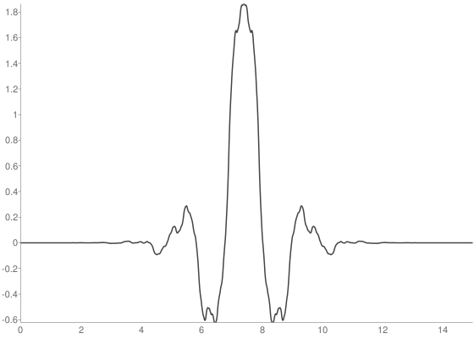
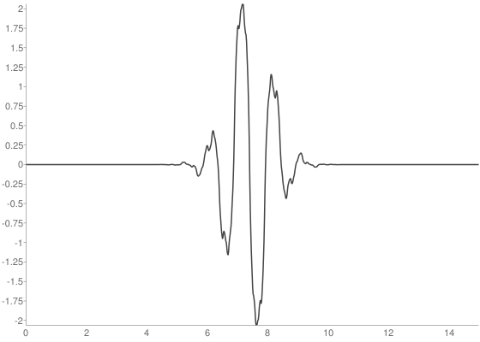
Biorthogonal Wavelet
Biorthogonal wavelets are families of compactly supported
symmetric wavelets. In the biorthogonal case, there are two
scaling functions that may generate different multiresolution
analysis, and accordingly two different wavelet functions.
Biorthogonal3.7 (bior3.7) is a symmetric biorthogonal wavelet.

Slide 11
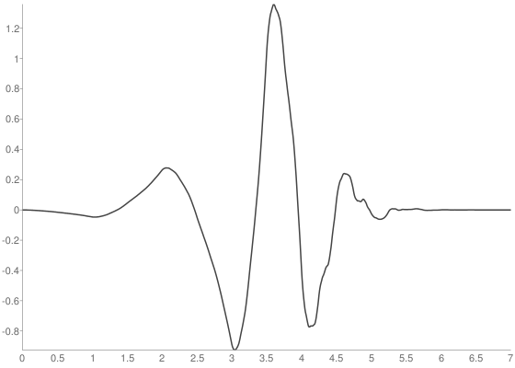
Daubechies Wavelet
Daubechies wavelet was chosen for this project on the basis
of the resemblance and similar frequency response
characteristics of the DB4 basis function with the ECG waveform.
Daubechies4 (db4) wavelet belongs to asymmetric, orthogonal,
biorthogonal and compactly supported families of wavelet.

Slide 12
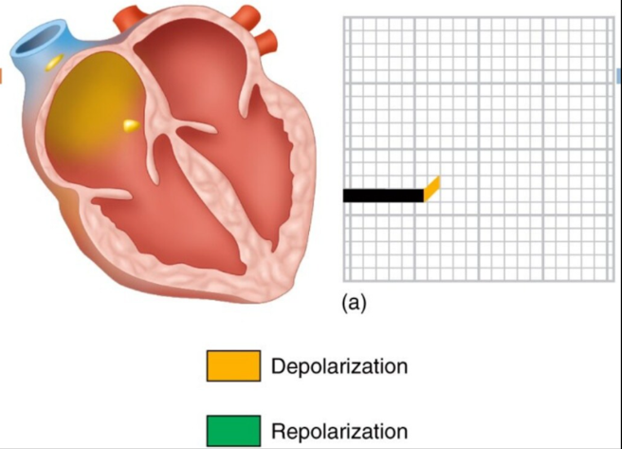
Generation of PQRST Waves

Slide 13
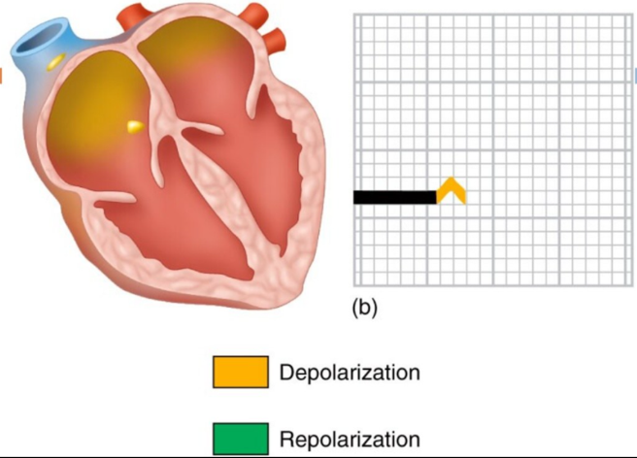
Generation of PQRST Waves

Slide 14
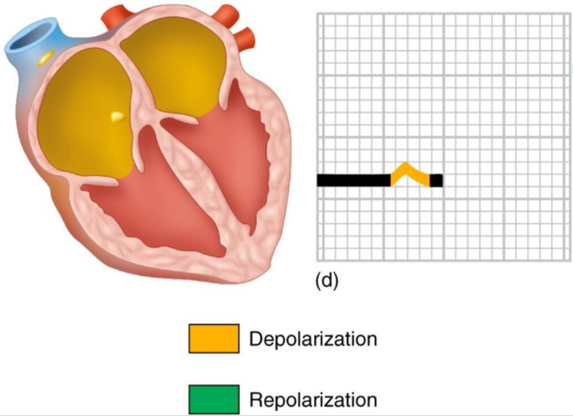
Generation of PQRST Waves

Slide 15
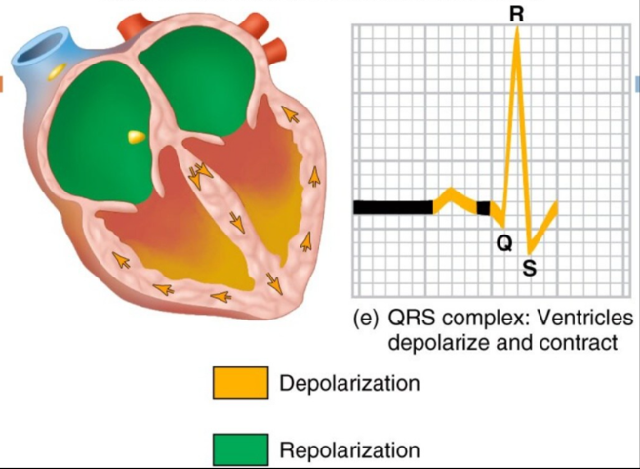
Generation of PQRST Waves

Slide 16
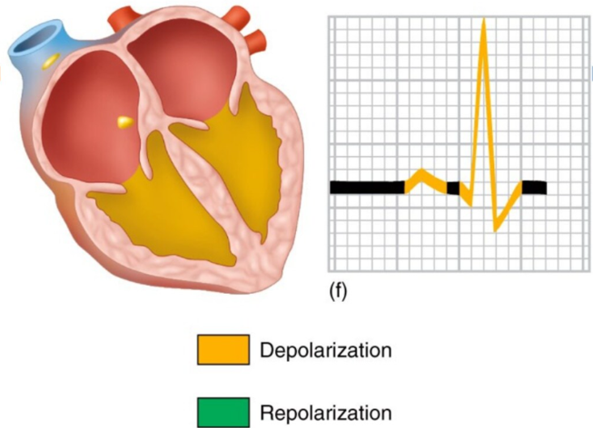
Generation of PQRST Waves

Slide 17
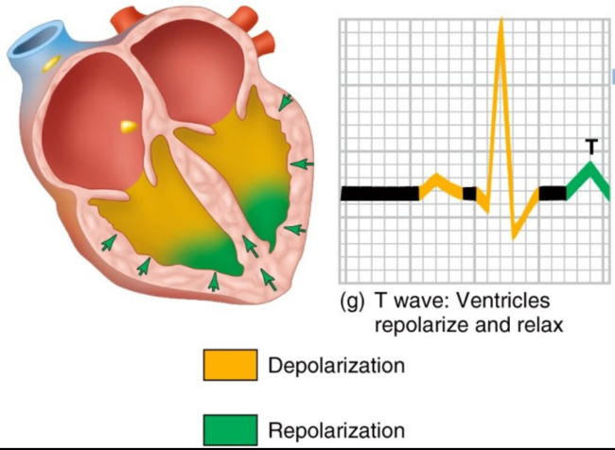
Generation of PQRST Waves

Slide 18
Elements of ECG Signal
PR Complex: It represents atrial depolarization, and it marks the onset of P wave. Normal duration 0.12-2.0 sec. Prolonged duration of PR complex indicates first degree of heart block.
QRS Complex: It represents ventricular depolarization. Amplitude of normal QRS complex is 5-30mm high and the duration is 0.06 – 0.12 sec. Its duration and amplitude are useful in diagnosing cardiac arrythmias, myocardial infarction etc.
QT Complex: It represents ventricular repolarization, and it marks the end of T wave. Normal duration is usually about 0.4 sec.

Slide 19
Scope and Limitation of the study
In this study, we have used discrete wavelet transform for denoising ECG signals. Discrete Wavelet Transform (DWT) is a transformation that can be used to analyze the temporal and spectral properties of linear and non-stationary signals like audio but almost all real signals are non-linear.
Therefore, denoising of ECG signals can be done using Empirical Mode Decomposition (EMD) technique.
Another limitation is the use of notch filter for the removal of powerline interference. So, one can use discrete wavelet transform based on component retrieval technique.

Slide 20
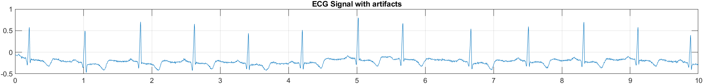
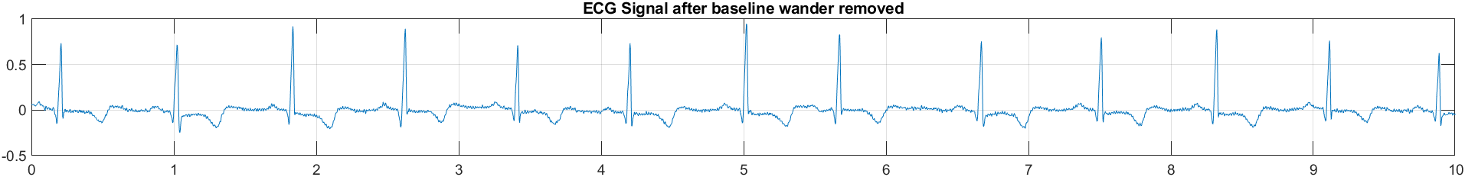
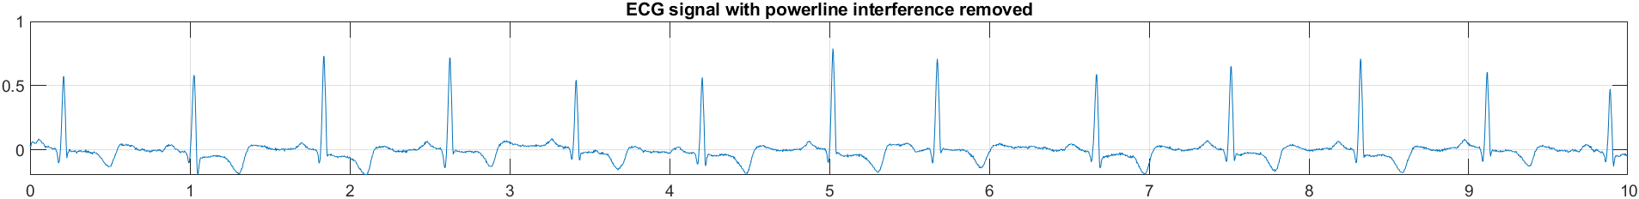
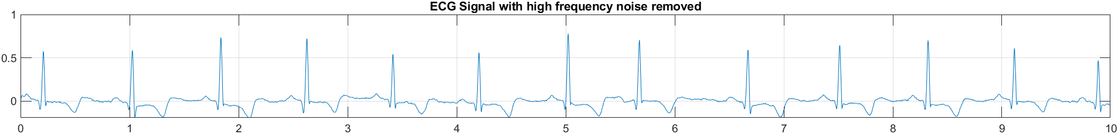
MATLAB Simulation Results

Slide 21
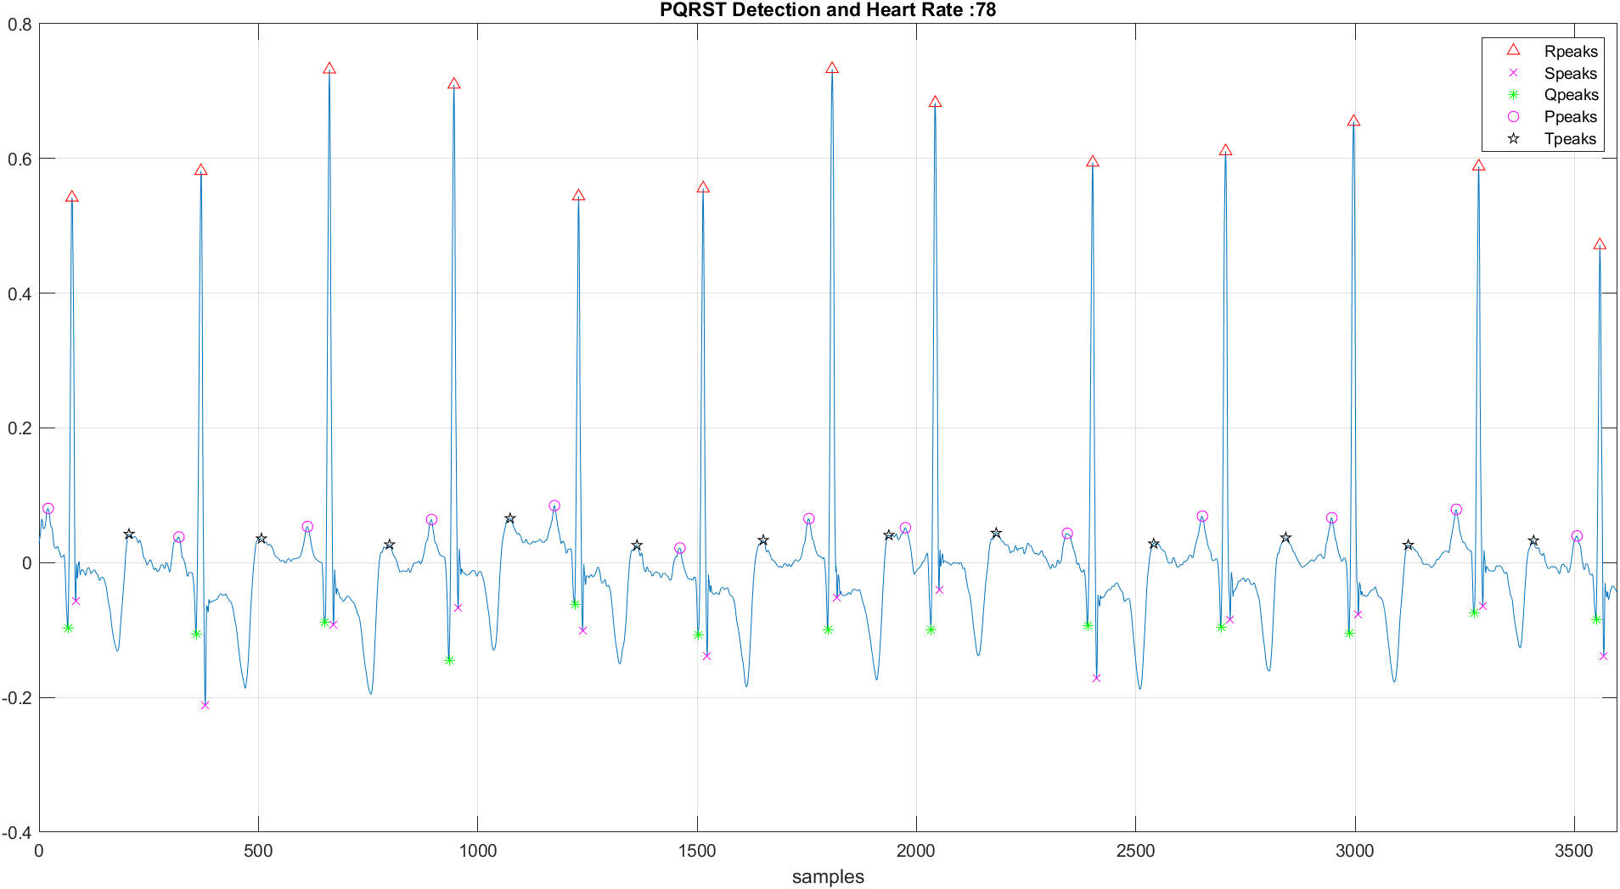
MATLAB Simulation Results

Slide 22
References
[1] Rahul Kher (2019), “Signal Processing Techniques for Removing Noise from ECG Signals”, J Biomed Eng 1: 1-9.
[2] S. T. Prasad and S. Varadarjan, “ECG Signal Processing Using Digital Signal Processing Techniques”, International Journal of Scientific & Engineering Research, Volume 4, Issue 12, December-2013
[3] T. Sharma and K. K. Sharma, “Power Line Interference Removal from ECG Signals Using Wavelet Transform based Component-Retrieval”, Department of Electronics and Communication Engineering, 2016 ICACCI, Sept. 21-24, 2016, Jaipur, India.
[4] S. Saxena, R. Jais and M. K. Hota, “Removal of Powerline Interference from ECG Signal using FIR, IIR, DWT and NLMS Adaptive Filter”, International Conference on Communication and Signal Processing, April 4-6, 2019, India.
[5] Albao, Baloaloa, Bambilla, et. al., “ECG Signal Processing”. [Online]. Available: Ecg Signal Processing (slideshare.net)
[6] “WAVELET BROWSER BY PYWAVELETS”, [Online]. Available: Daubechies 4 wavelet (db4) properties, filters and functions - Wavelet Properties Browser (pybytes.com)

